Slide 1
Overview Umbowo hwemadzimai, vamwe vavo uye vemunharaunda

Slide 2
Zvii zvakabuda mutsvakurudzo ye ASPIRE?
Tichitarisa zvose, tsvakurudzo ye ASPIRE (MTN 020) yakaratidza kuti ring yedapivirine yemukati menhengo yesikarudzi yemudzimai (dapivirine vaginal ring) yakadzivirira hutachiwana hwe HIV zvingangosvika chikamu chimwe chete pazvitatu (1/3).
Notes:
Pakati pemadzimai aive nemakore anopfuura makumi maviri nerimwe (21), akashandisa ring zvakanyanya nguva dzose kupfuura madzimai echidiki, hutachiwana hwe HIV hwakadzivirirwa nechikamu chinodarika pakati nepakati (1/2). Mu ASPIRE kudzivirira kwakanyanya kwakaonekwa pane vainyanya kuishandisa (kupfuura vaviri pazvikamu zvitatu)

Slide 3
Zvii zvakabuda mutsvakurudzo ye ASPIRE?
Kufanana nedzimwe nzira dzekudzivirira, ring inoshanda bedzi kana ikashandiswa zvakanaka uye nguva dzose. Ring zvakare yakanga isina njodzi , zvichireva kuti haina kukonzera matambudziko ehutano akakura.
Notes:
Imwe tsvakurudzo yakaongorora ring yedapivirine yemukati menhengo yesikarudzi yemudzimai, inonzi IPM 027 (The Ring Study) yakaratidza zvakabuda zvakafanana.

Slide 4
Uku kubudirira kukuru kwakanga kusingakwanisiki pasina kuzvipira kwemadzimai edu aiva mutsvakurudzo!
Zvii zvakabuda mutsvakurudzo ye ASPIRE?

Slide 5
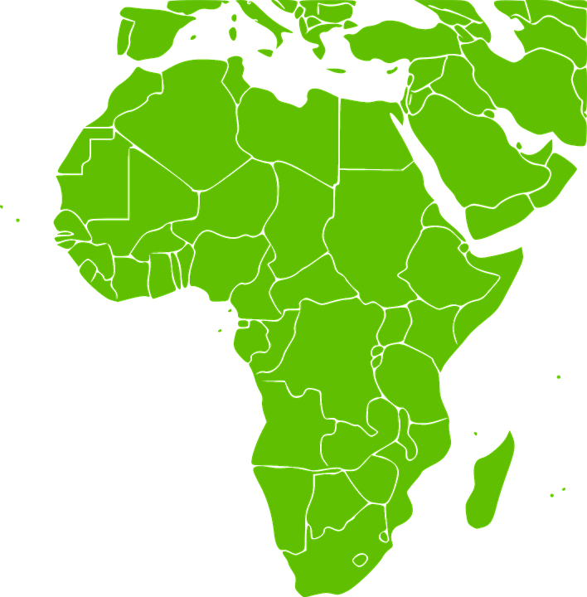
Ko ring yedapivirine yemukati menhengo yesikarudzi yemudzimai ichawanikwa riini munharaunda dzedu?
IPM, boka rakagadzira ring, ririkushanda nehurumende uye vamwe vavo nechinangwa chekuti ring iwanikwe munharaunda dzedu.
Hatizivi kuti ring ichabvumidzwa, kana kuti zvichanyatsotora nguva yakadini ring isati yave kuwanikwa, asi hurongwa hwacho hunowanzotora makore akawanda.
Notes:
Uhu hurongwa hunosanganisira mvumo kubva kune vanoona nezvetsvakurudzo uye zvinobvumidzwa munyika iyoyo uye chimwe nechimwe chinotora nguva.

Slide 6
Nei tsvakurudzo ye HOPE irikuitwa?
HOPE itsvakurudzo ye Open- Label Extension
(OLE ) yakarongwa kupa varimutsvakurudzo mukana wokusarudza kushandisa chigadzirwa chinoshanda chetsvakurudzo chisati chawanikwa munharaunda.
Notes:
Tsvakurudzo dze Open- Label Extension dzinoitwazve kuwana umbowo hwakapamhidzirwa pamusoro pechigadzirwa,zvakafanana nokushaya njodzi uye kushandisa nemazvo.

Slide 7
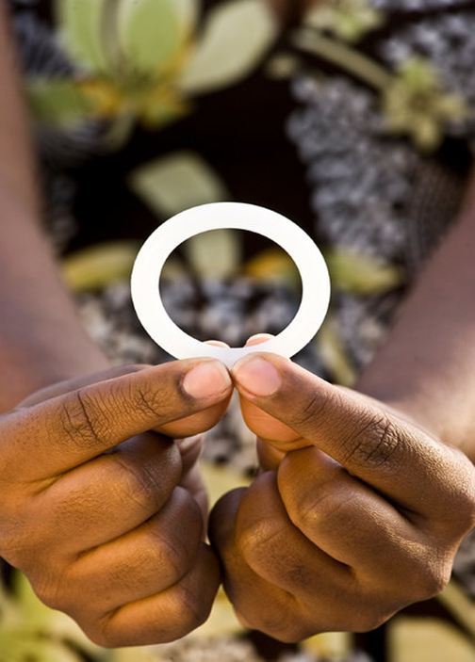
Chinangwa chikuru chetsvakurudzo ye HOPE kupa vari mutsvakurudzo mukana wokusarudza ipapo ipapo kushandisa ring yedapivirine yemukati menhengo yesikarudzi yemudzimai, yakaonekwa kuti haina njodzi uye kuderedza njodzi yokubatira HIV.
Nei tsvakurudzo ye HOPE irikuitwa?

Slide 8
Ndiani unokodzera kupinda mutsvakurudzo ye HOPE?
Parizvino, madzimai akanga ari mutsvakurudzo ye ASPIRE chete ndivo vachapiwa mukana wokupinda mu HOPE.
Madzimai anofanira kunzwisisa zvinodikanwa mutsvakurudzo, uye vobvuma kupindamo.

Slide 9
Ndiani unokodzera kupinda mutsvakurudzo ye HOPE?
Madzimai anofanira kunge aine hutano hwakanaka, vasina HIV, uye vasina pamuviri kana kuyamwisa.
Madzimai achaitwa ongororo dzezveutano uye ongororo dzokutsinhira kuti vanokodzera kupinda mu HOPE.

Slide 10
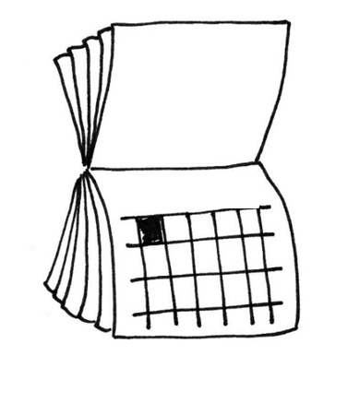
Ko tsvakurudzo yakareba sei? Ko kushanya kutsvakurudzo kunoitwa kangani?
Mudzimai woga woga achapinda mu HOPE achange arimo kwenguva ingangoita gore rimwe.
Kushanya kutsvakurudzo kuchaitwa mwedzi woga woga kwemwedzi mitatu yokutanga,uye zvakare kamwe pamwedzi mitatu yoga yoga mushure mazvo.

Slide 11
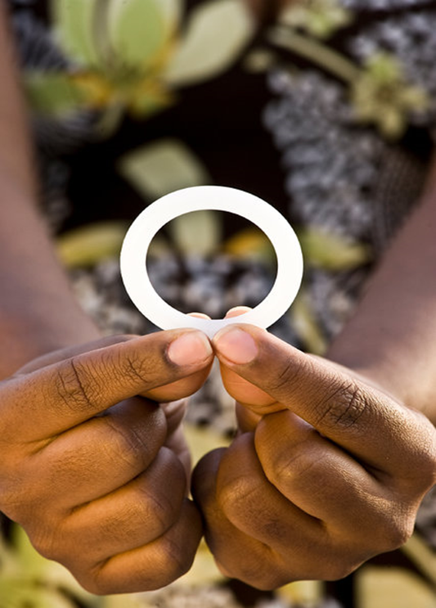
Ko maring emukati menhengo yesikarudzi yemudzimai akadini mu HOPE?
Madzimai ose achapiwa ring yemukati menhengo yesikarudzi yemudzimai ine dapivirine kana vachiida, kuti vaishandise mwedzi wega wega.
Notes:
Zvisina kufanana ne ASPIRE, HAPANA maring echiyereso (placebo)(asina mushonga) mu HOPE.

Slide 12
Chii chichakumbirwa madzimai achapinda muHOPE kuti aite?
Vose vemutsvakurudzo vanokodzera kupinda vachakokwa kupinda muHOPE uye kuuya kukushanya kwakatarwa kwetsvakurudzo nguva dzose.

Slide 13
Chii chichakumbirwa madzimai achapinda muHOPE kuti aite?
Vose vari mutsvakurudzo vachapiwa ring yedapivirine yemukati menhengo yesikarudzi yemudzimai kana vachiida kuti vaishandise mwedzi woga woga.
Madzimai anokwanisa kupinda mutsvakurudzo zvisinei nokuti vasarudza ring senzira yokudzivirira HIV kana kuti havana.

Slide 14
Chii chichakumbirwa madzimai achapinda muHOPE kuti aite?
Madzimai anosarudza ring senzira yokudzivirira HIV vachapangwa mazano nokudzidziswa pamusoro pekushandisa ring uye vachakumbirwa kupindura mibvunzo pamusoro pekushandisa ring

Slide 15
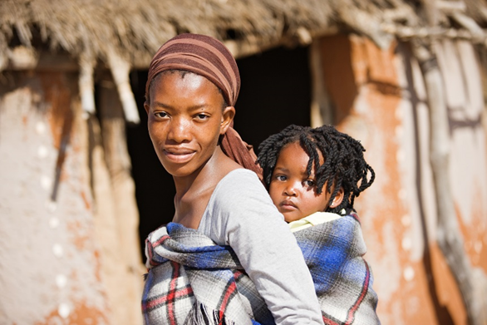
Chii chichakumbirwa madzimai achapinda muHOPE kuti aite?
Vari mutsvakurudzo vanokwanisa kushandura pfungwa dzavo pamusoro pekushandisa ring kunyangwe mushure mekupinda mutsvakurudzo.
Rangarirai, zvakadaro, kuti ring inokwanisa kudzivirira HIV kana ichishandiswa chete.
Notes:
Vose vari mutsvakurudzo vanopa rubatsiro rwakakosha kutsvakurudzo chero vachitaurira vashandi vemutsvakurudzo pavanenge vasiri kushandisa ring.

Slide 16
Chii chichakumbirwa madzimai achapinda muHOPE kuti aite?
Vose varimutsvakurudzo, zvisinei kuti varikushandisa ring vachakumbirwa:
Kudaira mibvunzo pamusoro pehutano hwavo uye zvemasanganiro epabonde
Kupangwa mazano pamusoro pekuti njodzi ive shoma uye pamusoro pemakondomu
Kushandisa nzira yokuronga mhuri kudzivirira pamuviri.

Slide 17
Chii chichakumbirwa madzimai achapinda muHOPE kuti aite?
Vose varimutsvakurudzo, zvisinei kuti varikushandisa ring vachakumbirwa:
Panekumwe kushanya kuongororwa zvehutano.
Kuita ongororo dzemurabhoritari zvinosanganisira ongororo dzezvirwere zvepabonde, dzepamuviri uye dze HIV.
Kupa ropa,bvudzi uye zvitorwa zvemukati menhengo yesikarudzi yemudzimai zviri pakadonje.

Slide 18
Ko madzimai anoramba kupinda mu HOPE?
Kana wemutsvakurudzo akasarudza kuti haadi kupinda mu HOPE, uchabvunzwa kana achida kushanya kamwe chete kupa umbowo pamusoro pechikonzero nei asingadi kupinda.

Slide 19
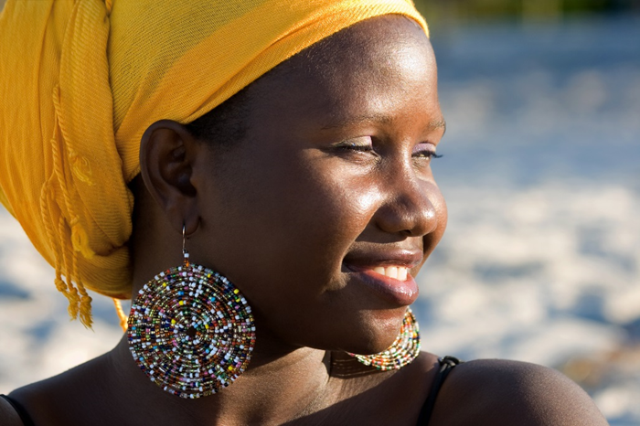
Ko madzimai anoramba kupinda mu HOPE?
Vemutsvakurudzo vakaramba kupinda mutsvakurudzo vangangoshandura pfungwa dzavo uye vopinda mu HOPE, ndokunge tsvakurudzo ichiri kuenderera mberi uye vachizadzikisa zvinodikanwa kupinda.

Slide 20
Ndedzipi njodzi?
Njodzi dzokuva mu HOPE dzakafanana nedzemu ASPIRE:
Mungangonzwa kusagadzikana kana kurwadziwa kunobva pakuongororwa kana pakutorwa ropa.
Ring yemukati menhengo yesikarudzi yemudzimai ingangoita kuti amwe madzimai anzwe kusagadzikana, vamwe vangangoita kuswinya,kuita zvinobuda, kana kunzwawo zvimwe.

Slide 21
Ndedzipi njodzi?
Mungangonzwa kunyadziswa nemibvunzo uye zvinoitwa mutsvakurudzo.
Zvinogona kuitika kuti imi kana umwe wenyu angangonzwa ring pamunenge muchisangana pabonde.

Slide 22
Ndedzipi njodzi?
Muchiitiko chisingawanzoitika mukabatira HIV, munogona kuita kusadaira kumishonga kana mukaramba muchishandisa ring.
Zvinogona kuitika kuti vamwe vangangokubatai zvisina kunaka kana kuita rusaruro kwamuri nokuda kokuva mutsvakurudzo.

Slide 23
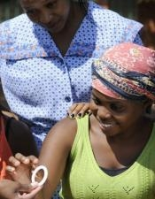
Zvii zvinowanikwa?
Panguva yokuva mutsvakurudzo, madzimai ari mu HOPE achapiwa mukana kana achida, wekupiwa ring yemukati menhengo yesikarudzi yemudzimai yakaonekwa isina njodzi uye ichishanda kudzivirira kubatira HIV.

Slide 24
Zvii zvinowanikwa?
Madzimai ari mutsvakurudzo achaongororwa zveutano, achaitwa ongororo dzekutarisa utano hwavo, kuronga mhuri, kupangwa mazano nokuongororwa HIV nezvirwere zvepabonde, nekurapiwa kana kutumirwa kune dzimwe nzvimbo, sezvingadiwa.

Slide 25
Chii chingaitwe ne vamwe uye vanhu vemunharaunda?
Kune madzimai anokodzera kupinda, kusarudza kupinda mu HOPE uye kushandisa ring isarudzo yemuridzi. Madzimai anokurudzirwa kukurukura sarudzo yavo nevamwe vavo uye nevamwe vanhu vakakosha kwavari.
Notes:
Vashandi vetsvakurudzo vachachengetedza umbowo pamusoro pamadzimai ari mutsvakurudzo zvakavanzika, asi varipozve kutaura pamusoro pe HOPE uye kupindura chero mibvunzo ine vamwe vavo kana vanhu vemunharaunda, sezvingadiwa. Nokutsigira, vamwe vavo uye vanhu vemunharaunda varikubatsiravo pakurwisa HIV/AIDS.

Slide 26
Kana muine mibvunzo kana kuti muchida umbowo hwakapamhidzirwa, ndapota shanyirai kiriniki yetsvakurudzo:

